Slide 1
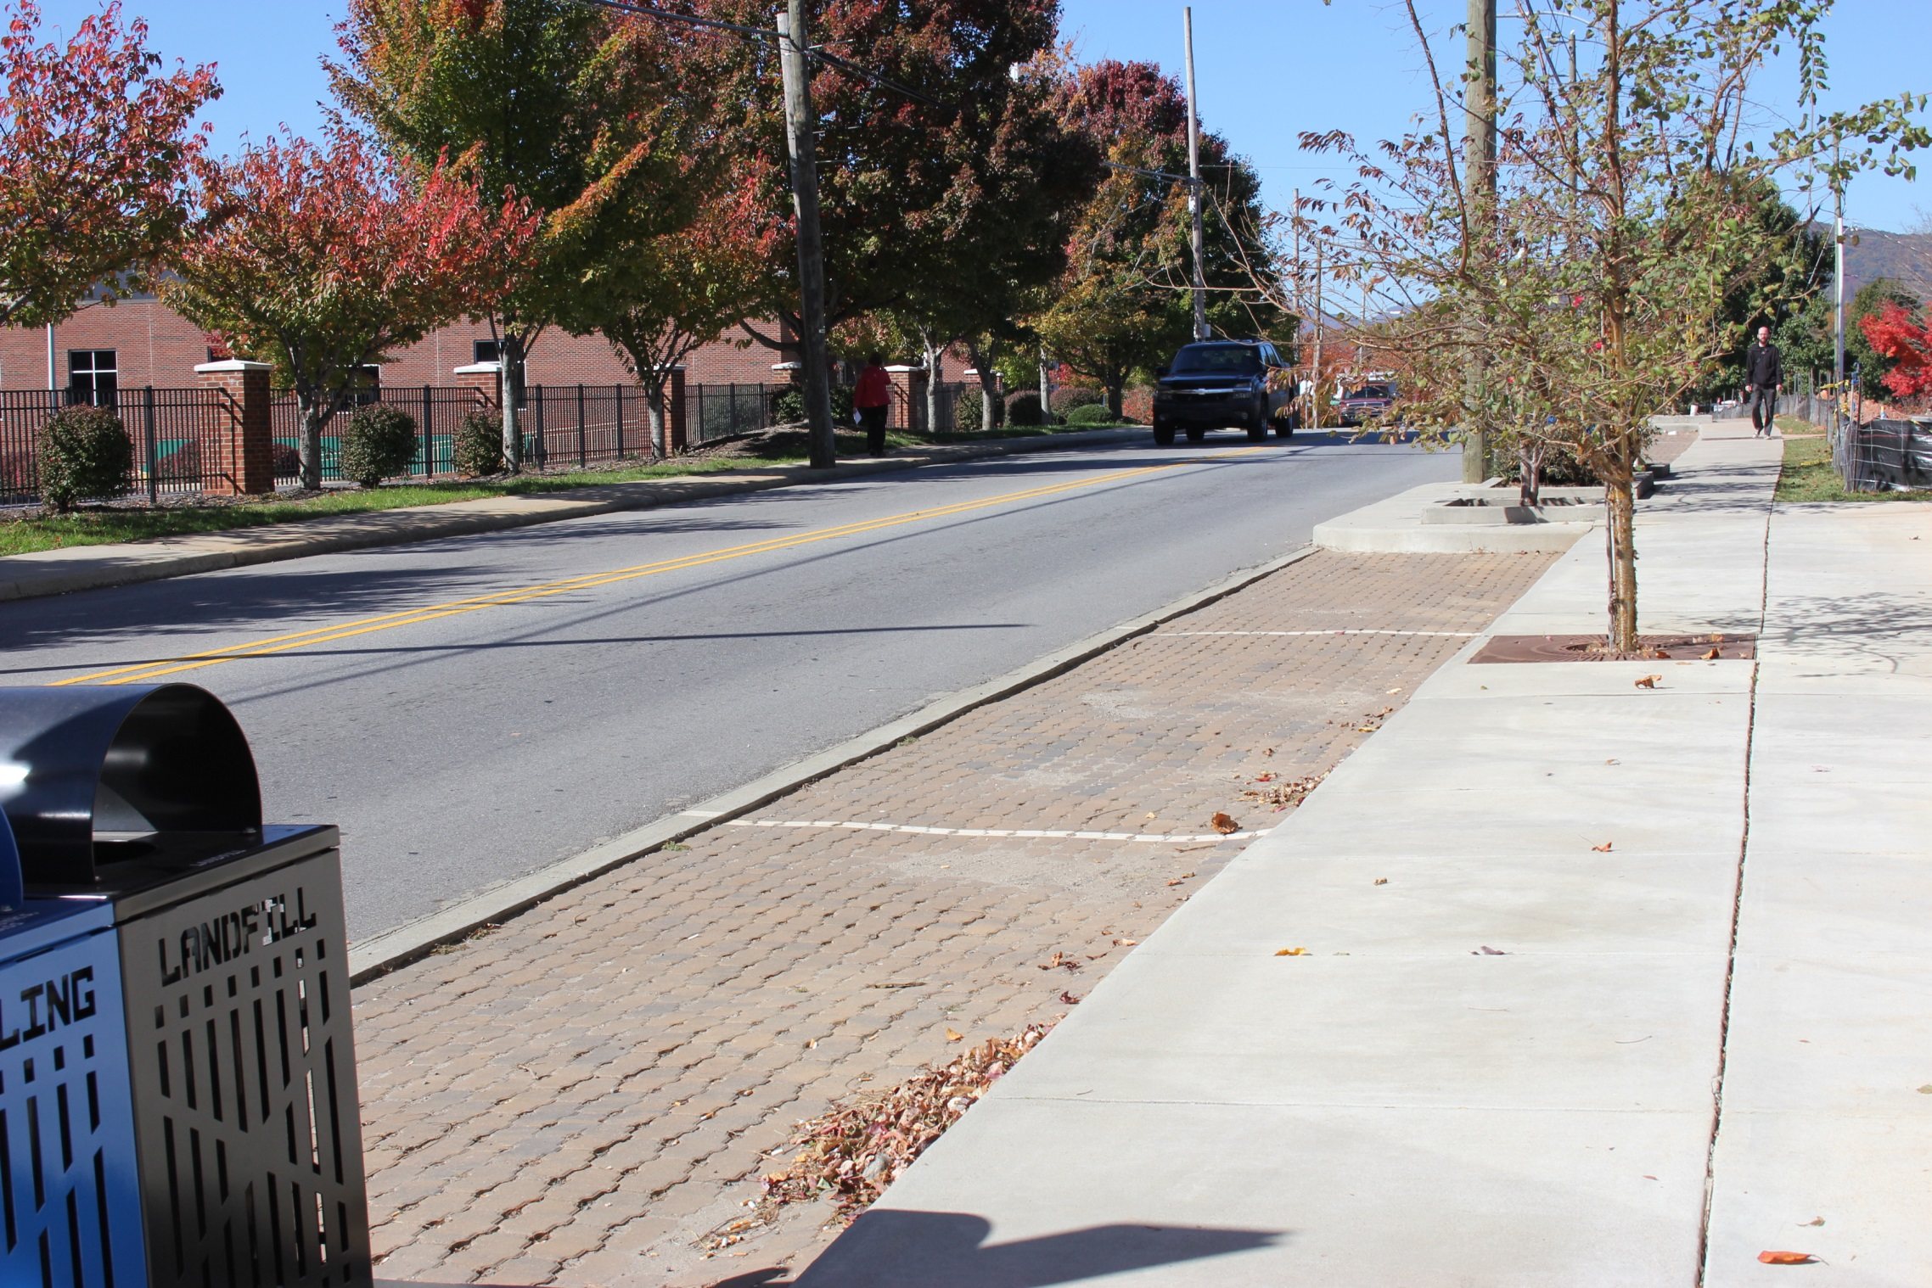
West Asheville Parking Study
Community Meeting
October 22, 2015

Slide 2
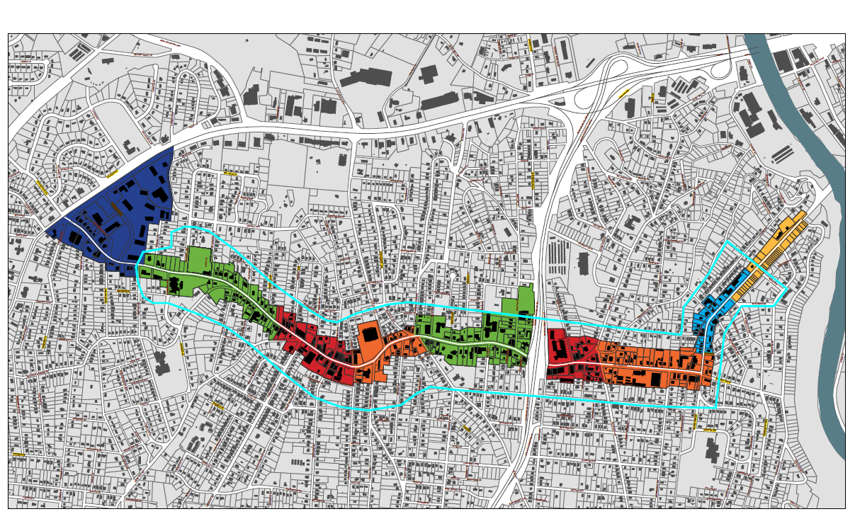
Study Area

Slide 3
Data Collection Summary
Corridor Parking Inventory
Study area length 3.5 miles
178 marked on-street parking spaces on Haywood Road
Estimated number of on-street parking spaces is 720 spaces
Estimated number of total parking spaces – 3,020
Largest supply of off-street parking
West Asheville Baptist Church – 309 spaces
Ingles – 157 spaces
Grace Baptist Church - 125
Calvary Baptist Church – 120 spaces

Slide 4
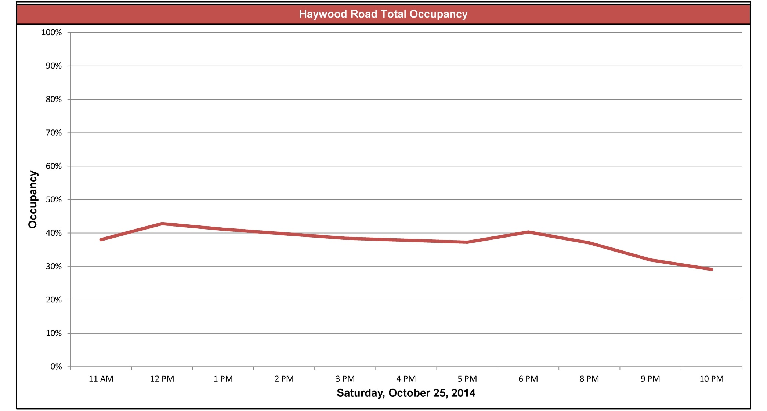
Data Collection Summary

Slide 5
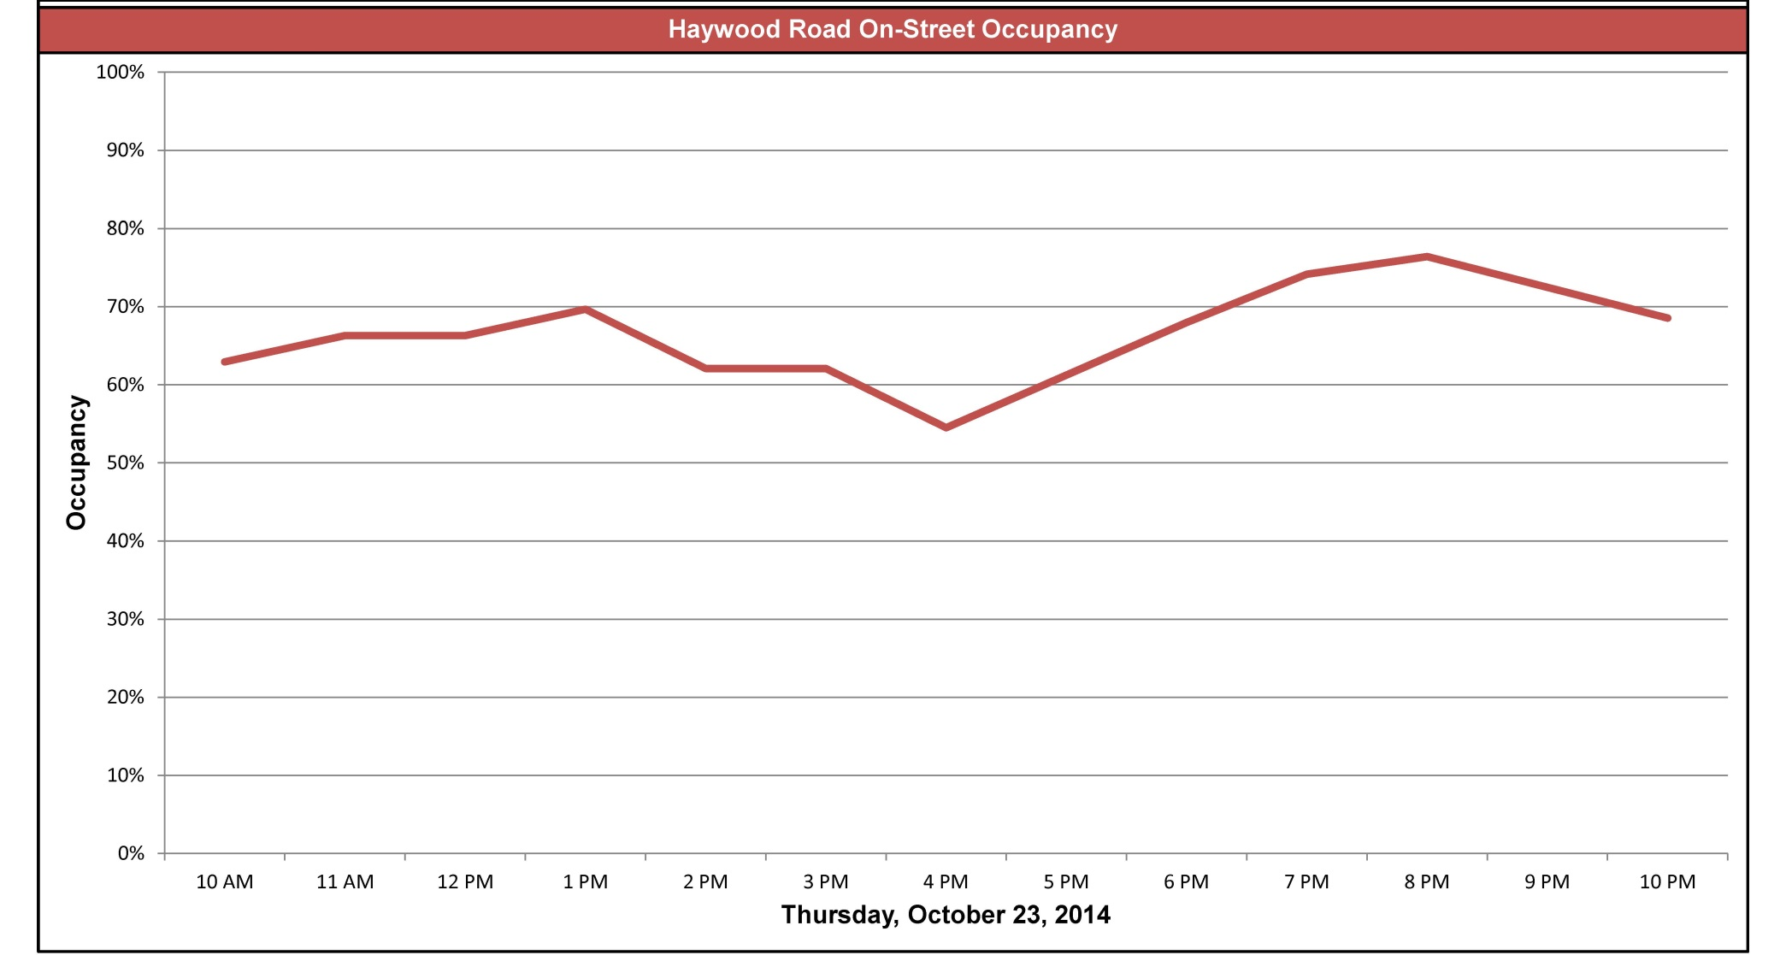
Data Collection Summary

Slide 6
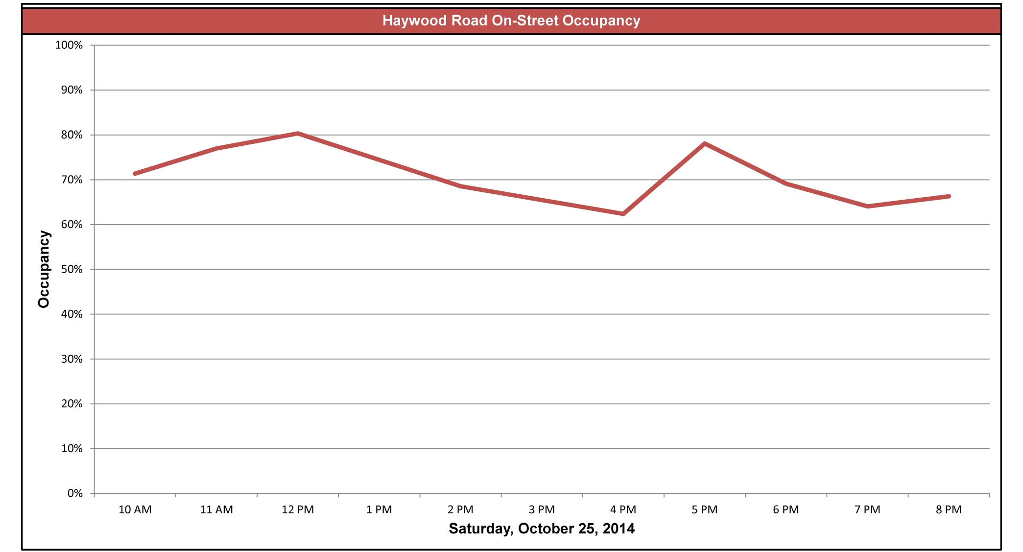
Data Collection Summary
?

Slide 7
Haywood Road Parking Study – Location 1 Oakwood Street – Louisiana Avenue

Slide 8
Haywood Road Parking Study – Location 1
Oakwood Street to Louisiana Avenue
735 parking spaces
133 on-street spaces
Peak Hour overall occupancy – 6 PM Thursday – 46%
Peak on-street occupancy – 6 PM Saturday – 103%
On-street occupancy > 80% - 7 out of 16 observed periods

Slide 9
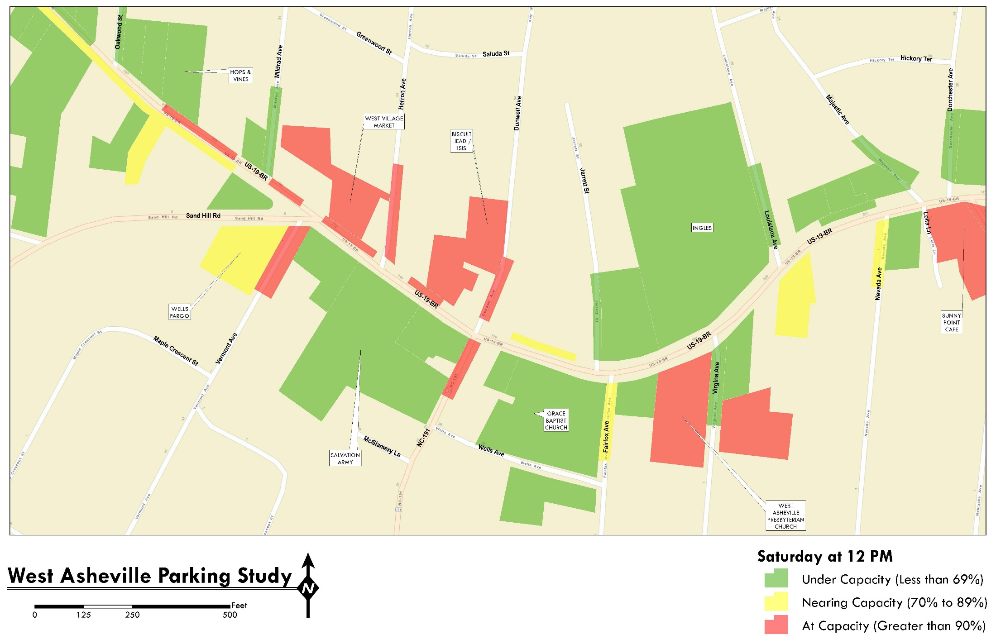
Haywood Road Parking Study – Location 1

Slide 10
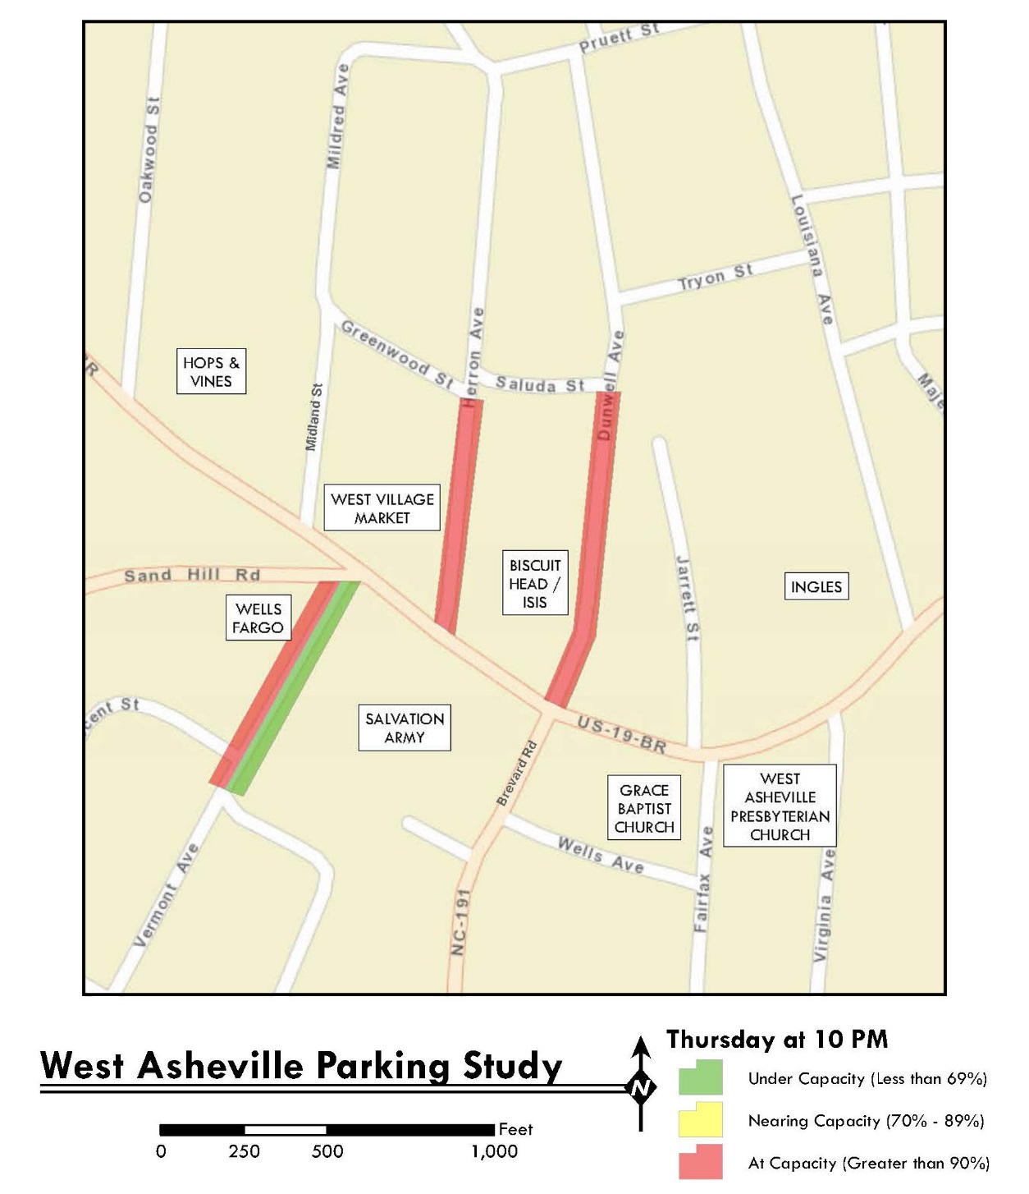
Haywood Road Parking Study – Location 1
Side Street Occupancy

Slide 11
Side Streets – Location 1
Herron Street
Approximately 10 spaces of parking on East Side
Posted Parking Restriction on West Side
Parked vehicles range 11-15
Observed peak (15) at 8PM
Dunwell Avenue
Approximately 22 spaces of parking on East Side
NO Posted Parking Restriction on West Side
Parked vehicles range 8-21
Observed peak (21) at 10PM

Slide 12
Side Streets – Location 1(cont.)
Vermont Avenue
Approximately 10 spaces of parking on West side
Approximately 16 spaces of parking on East side
Parked vehicles
Range 5-13 vehicles on East side
Range 8-13 vehicles West
Observed Peak (13 both sides) at 8PM
Overall Parking demand is greatest between 8-10PM
On-street occupancy less than 80%; three of six observation periods

Slide 13
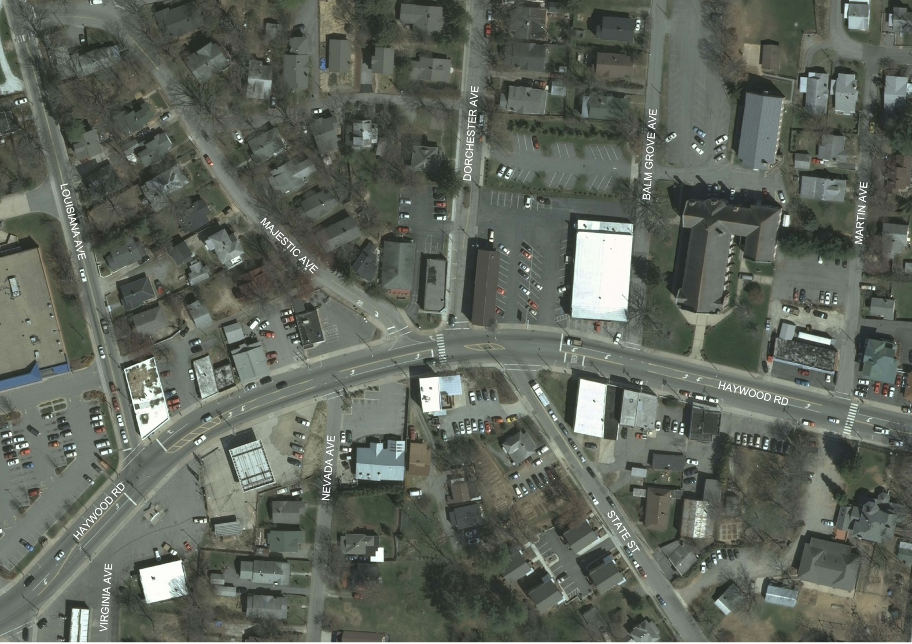
Haywood Road Parking Study – Location 2 Louisiana Ave – Martin Ave

Slide 14
Haywood Road Parking Study – Location 2
Louisiana Avenue to Martin Street
240 parking spaces
75 on-street spaces
Peak Hour overall occupancy – 3 PM Saturday – 68%
Peak on-street occupancy – 11 AM Saturday - 73%
On-street occupancy > 80% - 0 out of 16 observed periods

Slide 15
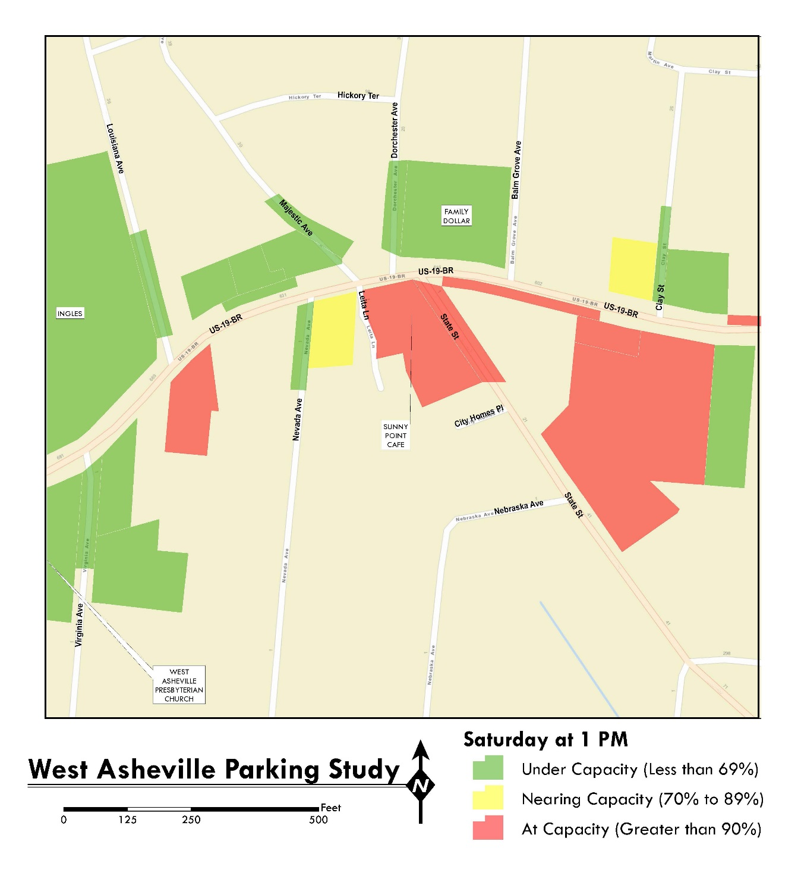
Haywood Road Parking Study – Location 2

Slide 16
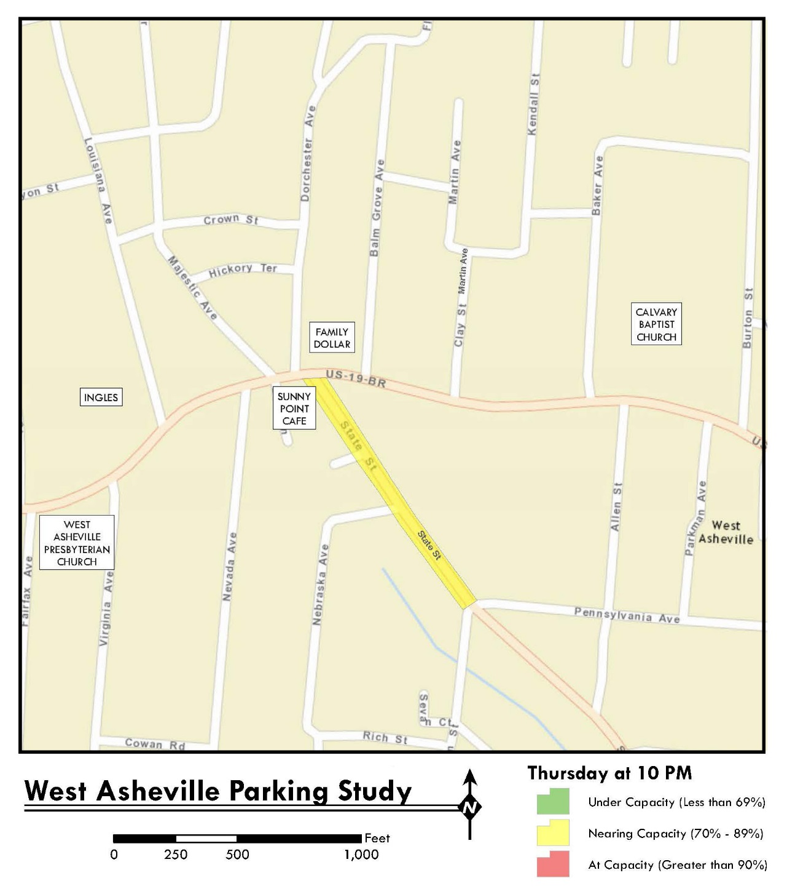
Haywood Road Parking Study – Location 2

Slide 17
Side Street - Location 2
State Street
Approximately 14 spaces of parking on West side
Posted Parking Restrictions on East side
Parked vehicles range 4-10 vehicles
Observed peak (10) at 8PM and 10 PM

Slide 18
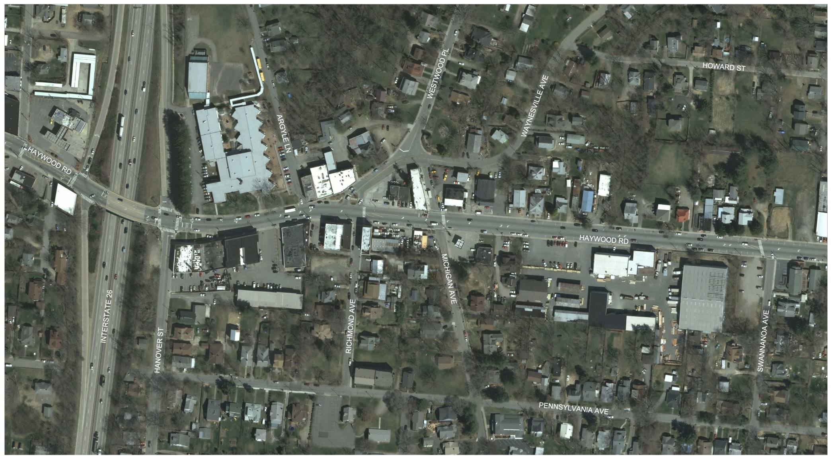
Haywood Road Parking Study – Location 3 I-26 interchange to Swannanoa Avenue

Slide 19
Haywood Road Parking Study – Location 3
I-26 interchange to Swannanoa Avenue
348 parking spaces
136 on-street spaces
Peak Hour overall occupancy – Noon Saturday – 66%
Peak on-street occupancy – Noon Saturday - 93%
On-street occupancy > 80% - 6 out of 16 observed periods

Slide 20
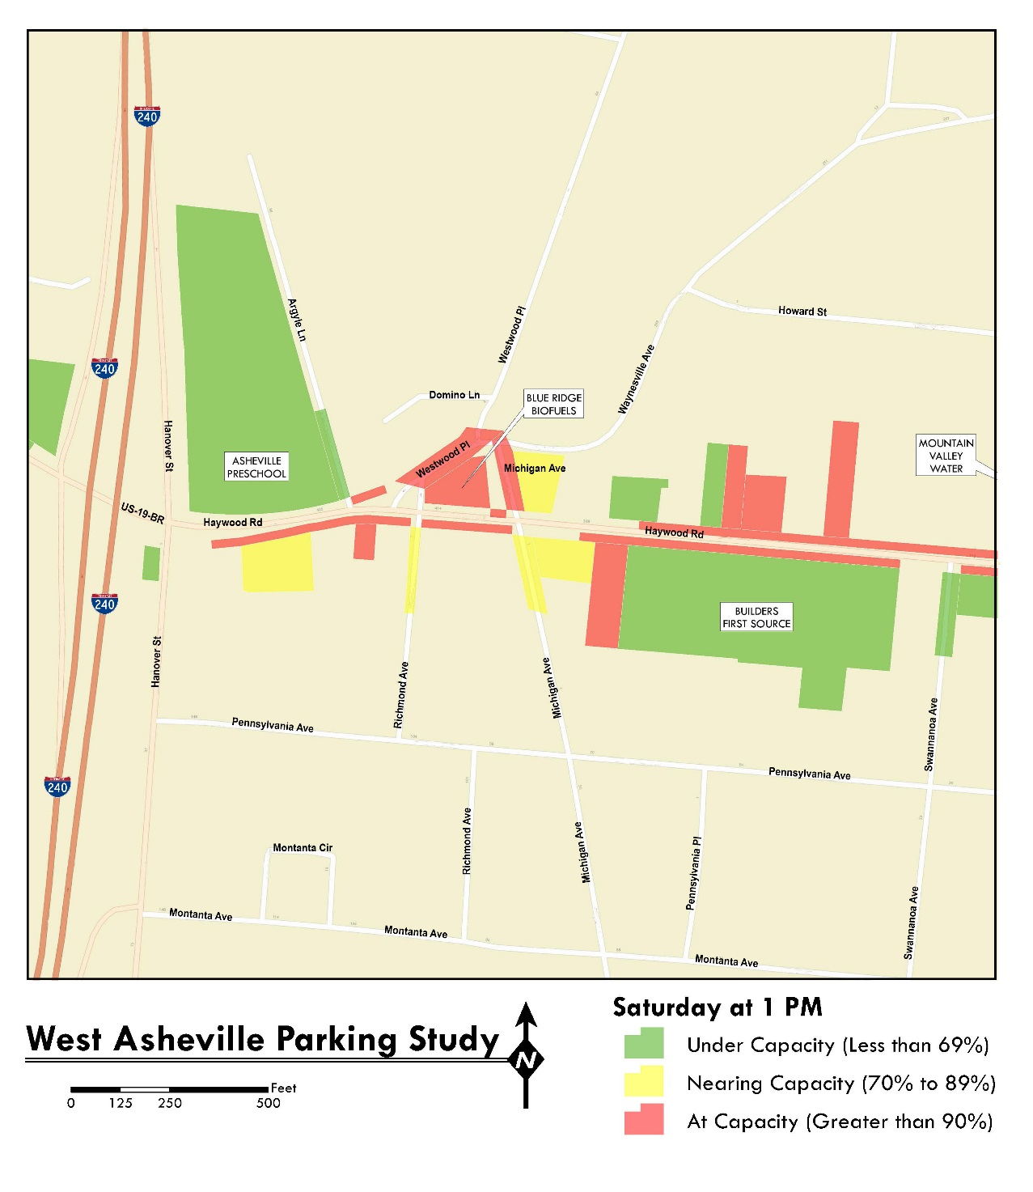
Haywood Road Parking Study – Location 3

Slide 21
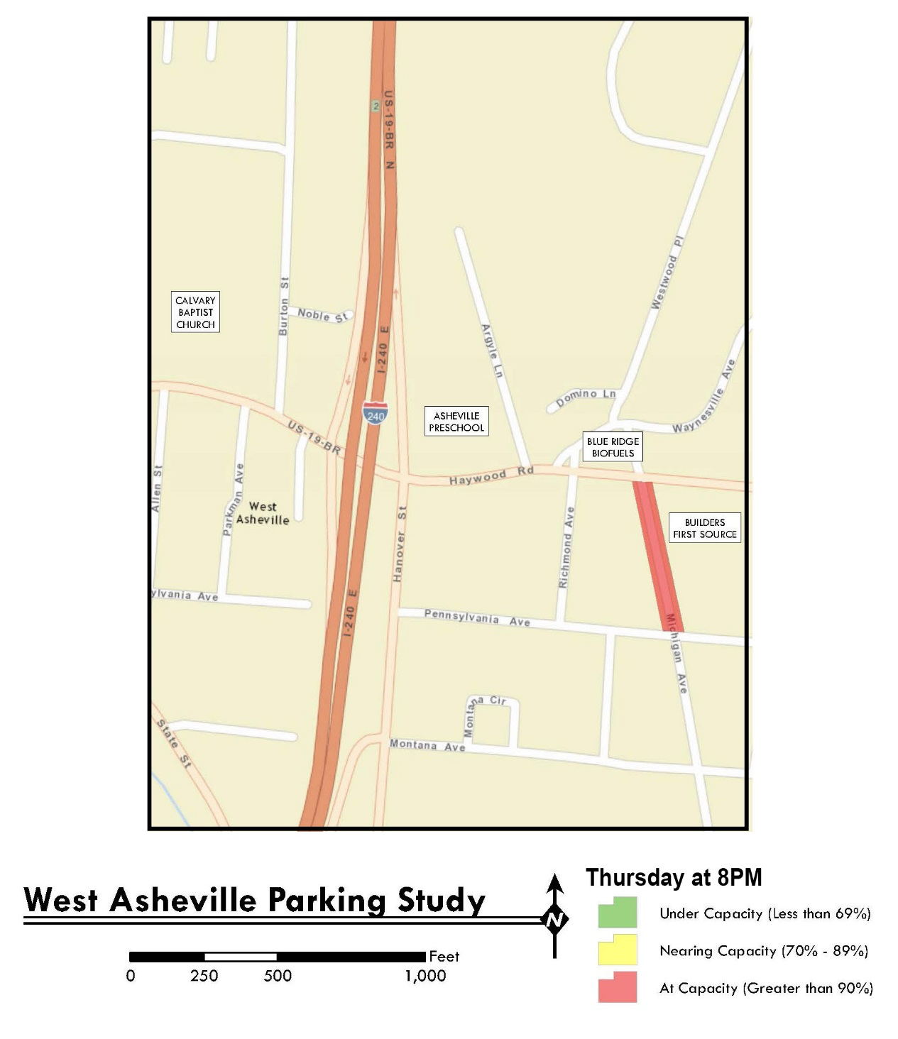
Haywood Road Parking Study – Location 3

Slide 22
Michigan Avenue Parking Study – Location 3
Approximately 13 parking spaces on East side
Posted Parking Restrictions on West side
Parked Vehicles range 9-13
Observed Peak (13) at 8PM

Slide 23
Findings
Overall there is available parking in West Asheville
Two (2) subareas experience parking issues
Oakwood St. to Louisiana Ave.
I-26 to Swannanoa Ave.
Abundance of private, off-street parking
Private off-street parking underutilized in peak
Heavy parking demand for on-street parking on side streets in study area
Significant amount of “informal” shared parking is occurring at churches and other locations

Slide 24
Live Polling

Slide 25
All expenses paid trip… where would you go?
Hawaii
New York
Paris
Rome
Barcelona
Seoul

Slide 26
Which of the following most accurately describes how you would complete the following sentence: “I visit the Haywood Road Corridor Area in West Asheville…”.
Daily
Once a week
2-4 times a week
A few times a month
A few times a year
I live in the Study Area
I do not visit the Study Area

Slide 27
How would you describe yourself? (Please select all that apply.)
I live here
I own a business here
I own property here
I am a regular visitor
I am an occasional visitor
I rarely visit
Other

Slide 28
How would you characterize parking in the Haywood Road Corridor Area?
Perfect – we don’t have a problem
It’s getting worse but there’s no need to make changes yet
It’s something we should study further
It’s unacceptable- we need a change

Slide 29
Which of the following statements would you suggest is most important?
The City needs to protect parking for local residents
We need improved parking accommodations for local businesses
We’re in this together and need a balanced solution

Slide 30
When visiting destinations in the Haywood Road Corridor Area, I typically (use)…
Drive alone
Carpool
Bike
Public transit
Walk
Carshare (Uhaul CarShare)
Rideshare (Uber, Taxi)
Other

Slide 31
Where do you typically have the greatest parking success (finding a space) during the weekday?
Haywood (Oakwood St to Louisiana Ave)
Haywood (Louisiana Ave to Martin St)
Haywood (I-26 an Swannanoa Ave)
Michigan Ave
State Street
Dunwell Avenue
Heron Street
Vermont Street

Slide 32
Where do you typically have the greatest parking success (finding a space) on the weekend?
Haywood (Oakwood St to Louisiana Ave)
Haywood (Louisiana Ave to Martin St)
Haywood (I-26 an Swannanoa Ave)
Michigan Ave
State Street
Dunwell Avenue
Heron Street
Vermont Street

Slide 33
How would you characterize current parking enforcement activities in the study area?
Too aggressive
Appropriate level of enforcement
More enforcement is needed

Slide 34
When considering methods to improve parking in the area, which of the following do you think are worth exploring?
Enforcement of existing parking restrictions (i.e., time limits)
Promote ease of access by bicycles and offer more bike parking)
Install parking meters
Improve transit access
Promote more walking trips through enhanced sidewalks
Implement a Residential Parking Permit Program
Build additional public parking
Promote more shared parking (use of existing private parking supply for public use)
None of the above

Slide 35
Please make your selection...
Answer A
Answer B

Slide 36
How do you think the City of Asheville should pay for parking management in the Study Area? (Please select all that apply.)
Parking meters/fees
Increased fines
Appropriations from General Fund
Introduce a Parking Assessment District (tax/fee to local residents and businesses)
We don’t have a parking problem

Slide 37
Who should be responsible for supporting the revenue required to implement an enhanced parking strategy for the area?
Local residents
Local businesses
Local parkers only (meters and fees)
The entire city

Slide 38
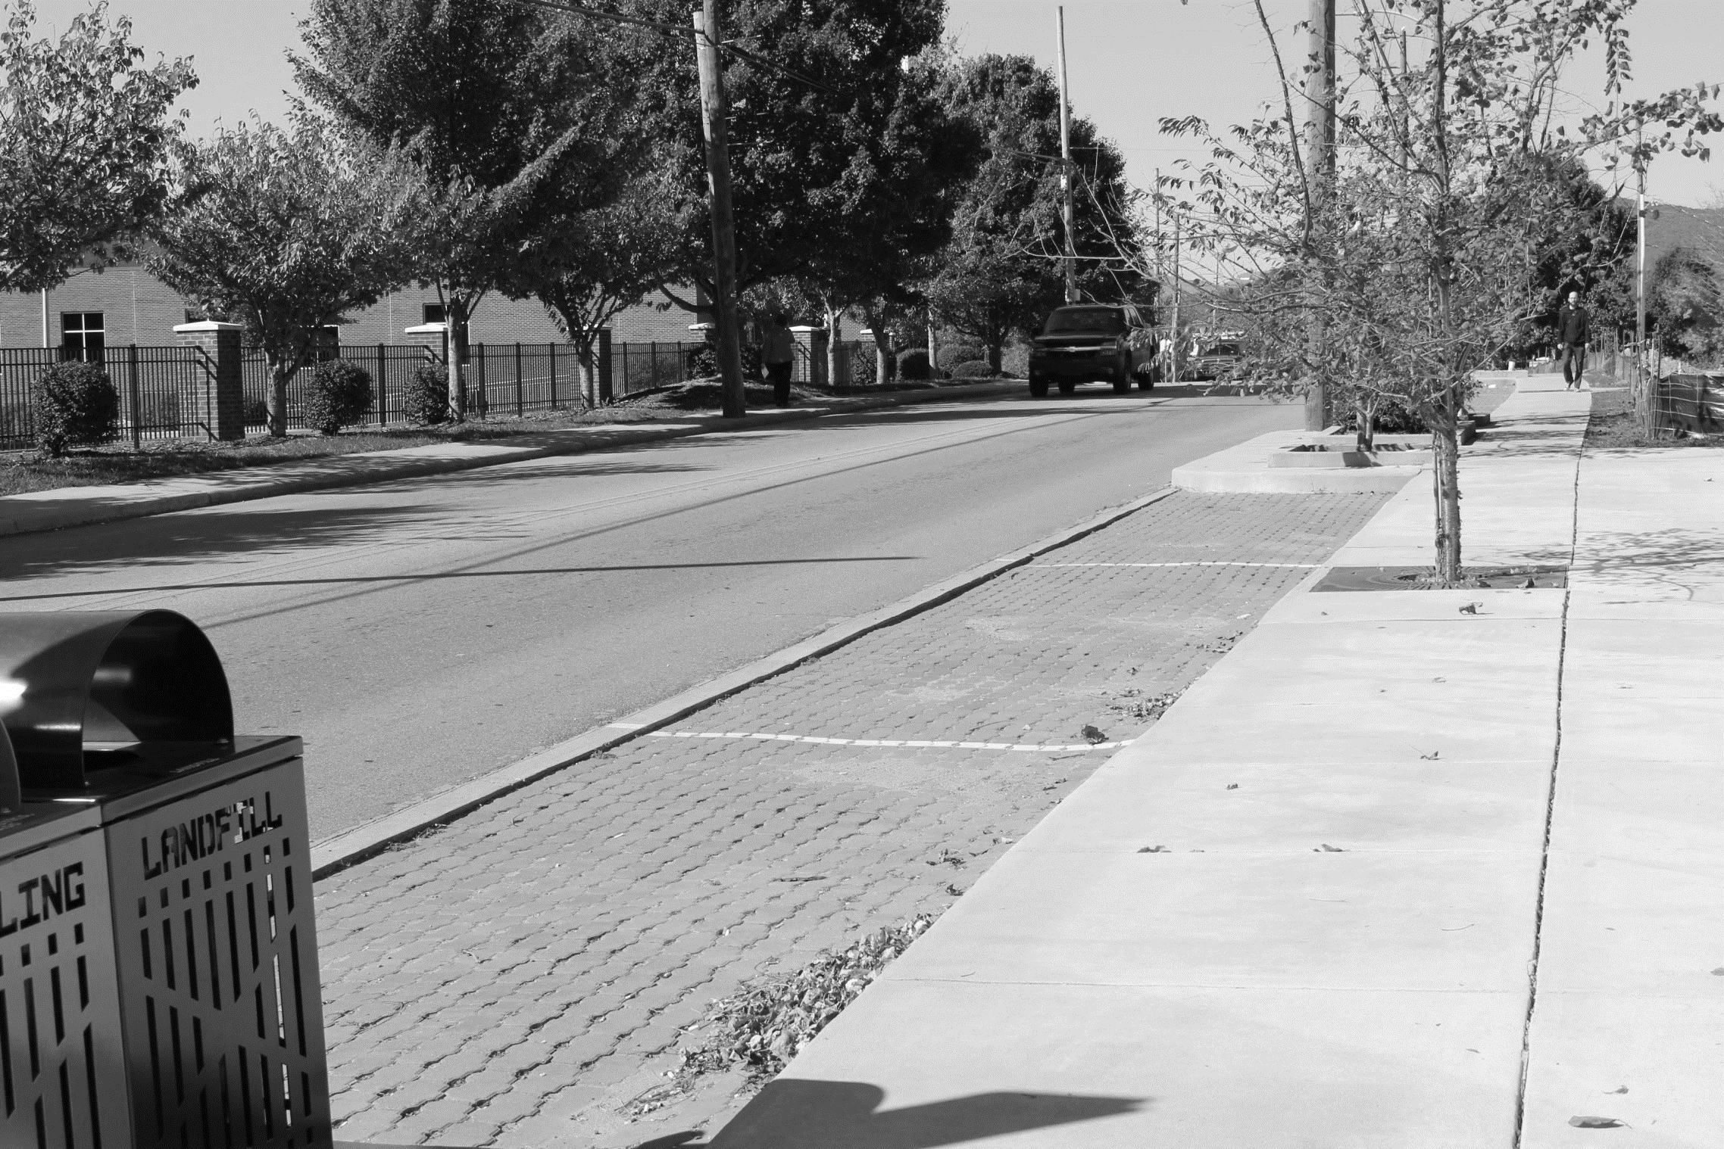
Questions?
Fred Burchett, Senior Vice President
Fred.Burchett@kimley-horn.com

